Slide 1
Inspirations

Slide 2
1. Čo všetko sa dnes kóduje v JavaScripte
DOM events, validations, HTML, CSS
Browser
Mobile
apps
React Native,...
Networking (AJAX apps), app logic
XHR
Web Sockets
nw.js, electron,...
Desktop UI
apps
JSON, JSONSchema, JWS, JWE, ...
Web Server
CLI
tests, administration, maintenance
Web Servers, middleware, proxies
tools, DevOps, ...
JS Queries, map, reduce
AI, CV, GEO, R, Alexa...
Cloud APIs
JSON Documents as model
Database
JS microcontrollers
Devices, IoT
tests, administration, JS scripts
JVM, Java, Nginx
Embeded
Notes:
TODO: animate

Slide 3
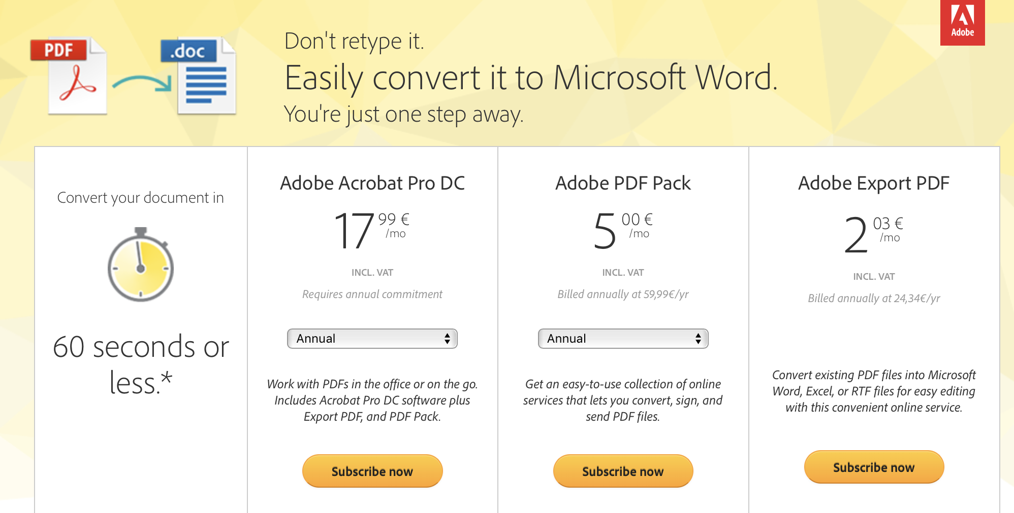
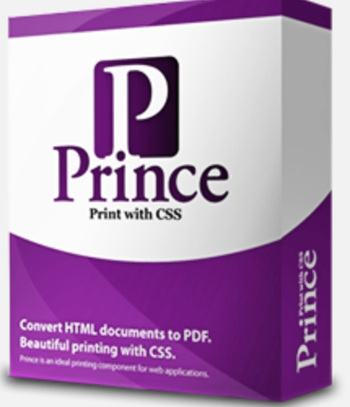
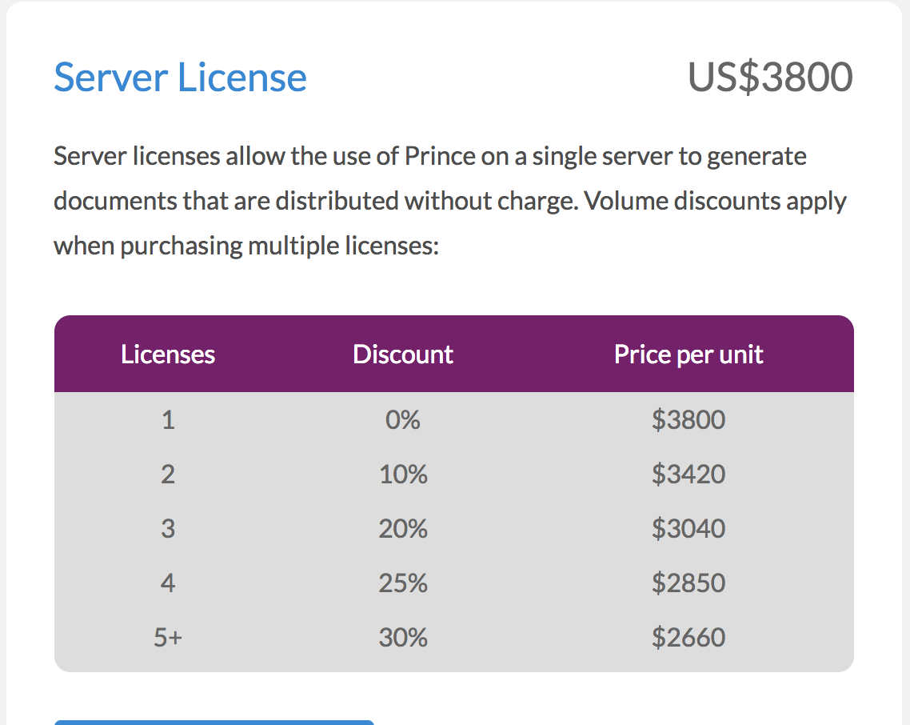
PDF.js https://github.com/mozilla/pdf.js/
Overview:
Motivation:
PDF.js is a Portable Document Format (PDF) viewer that is built with HTML5.
PDF.js is community-driven and supported by Mozilla Labs. Our goal is to create a general-purpose, web standards-based platform for parsing and rendering PDFs.
See also: https://github.com/coolwanglu/pdf2htmlEX/wiki/Comparison
Create free node.js library/web server to convert PDFs, extract TOC, extract images, count pages,...

Slide 4
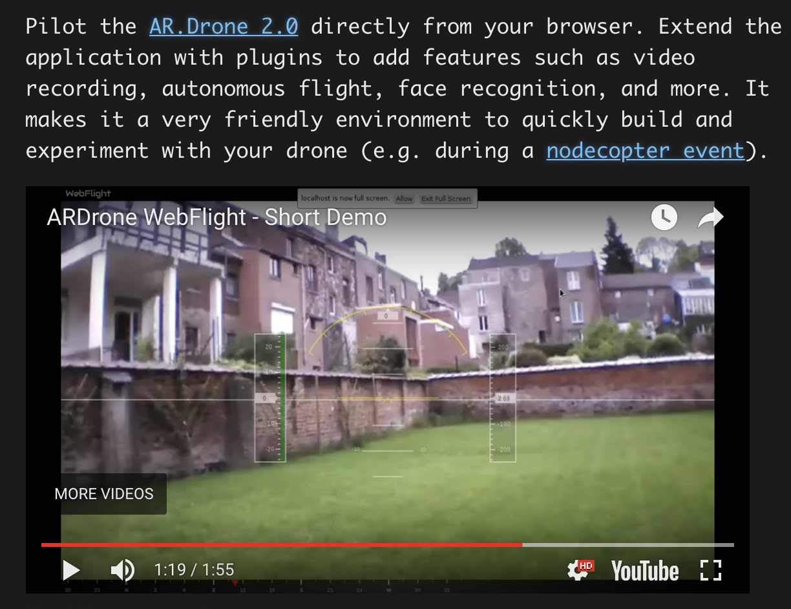
ardrone-webflight http://eschnou.github.io/ardrone-webflight/
Overview
Motivation
Good example how to controll „things“, stream video and many more

Slide 5
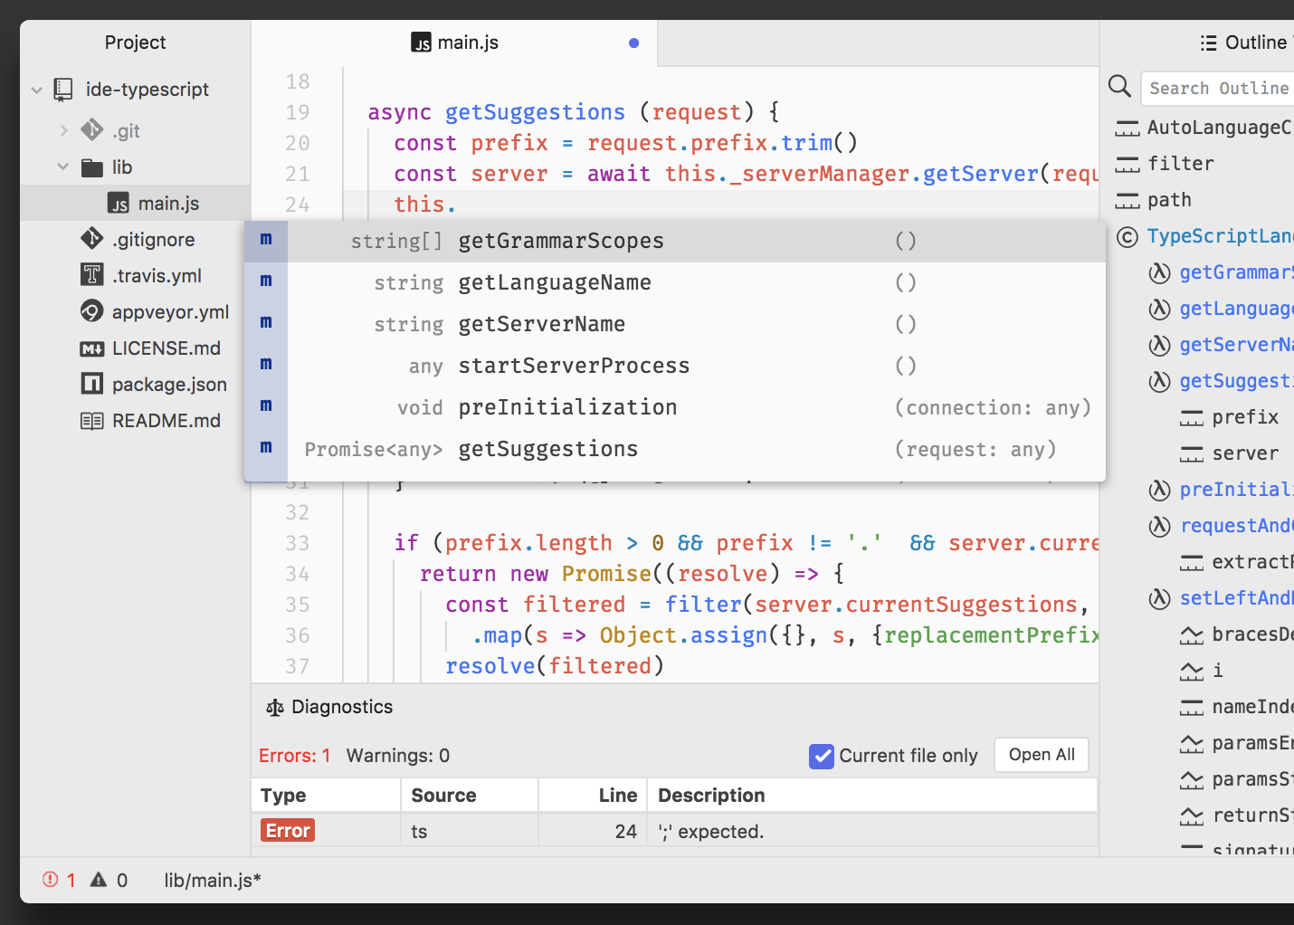
Atom - text editor for the 21st Century https://atom.io/
Overview
Motivation
Atom is a desktop application built with HTML, JavaScript, CSS, and Node.js integration. It runs on Electron
Hackable: https://blog.github.com/2016-08-19-building-your-first-atom-plugin/
Source codes: https://github.com/atom/atom

Slide 6
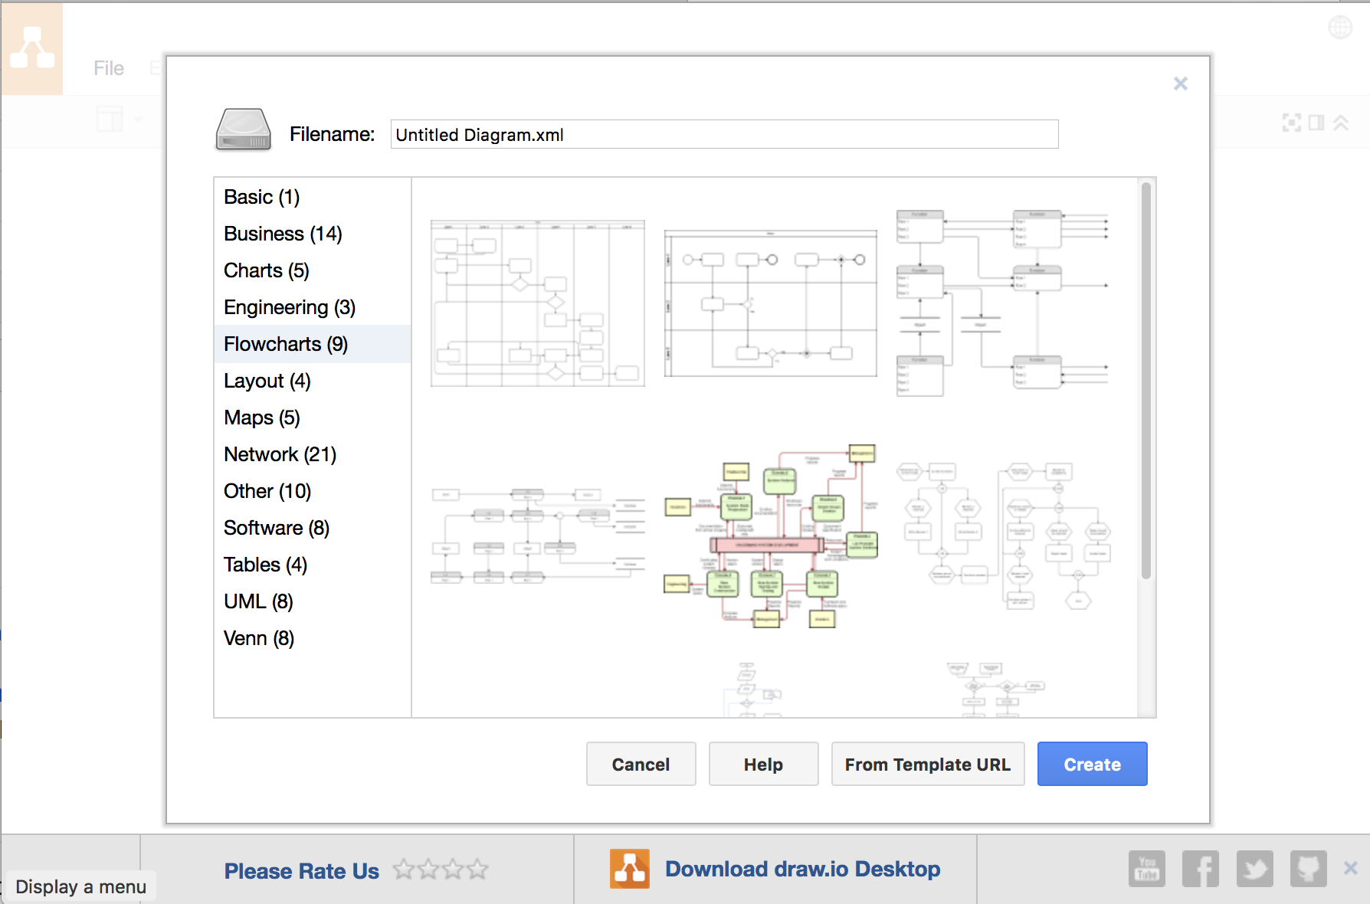
https://www.draw.io/ online diagramming web site + standalone app
Overview
Motivation
draw.io is an online diagramming web site that delivers the source in this project.
draw.io uses the mxGraph library
Contribute to real world application
Study UI source code
Study Web vs. Offline distribution and code reuse
Base for your diagramming projects
...

Slide 7
http://johnny-five.io/ The JavaScript Robotics & IoT Platform
Overview
Motivation
Johnny-Five is the JavaScript Robotics & IoT Platform. Released by Bocoup in 2012, Johnny-Five is maintained by a community of passionate software developers and hardware engineers
Programming HW requires usually more discipline and following best practices then pure SW programming
From toys and prebuild HW to real home devices and interesting well payed projects (security, surveilance, home entertainment,...)

Slide 8
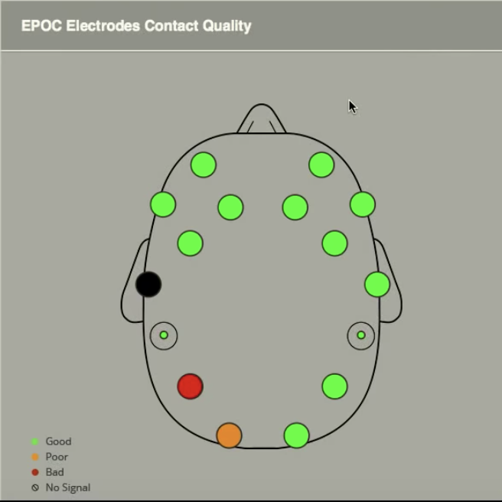
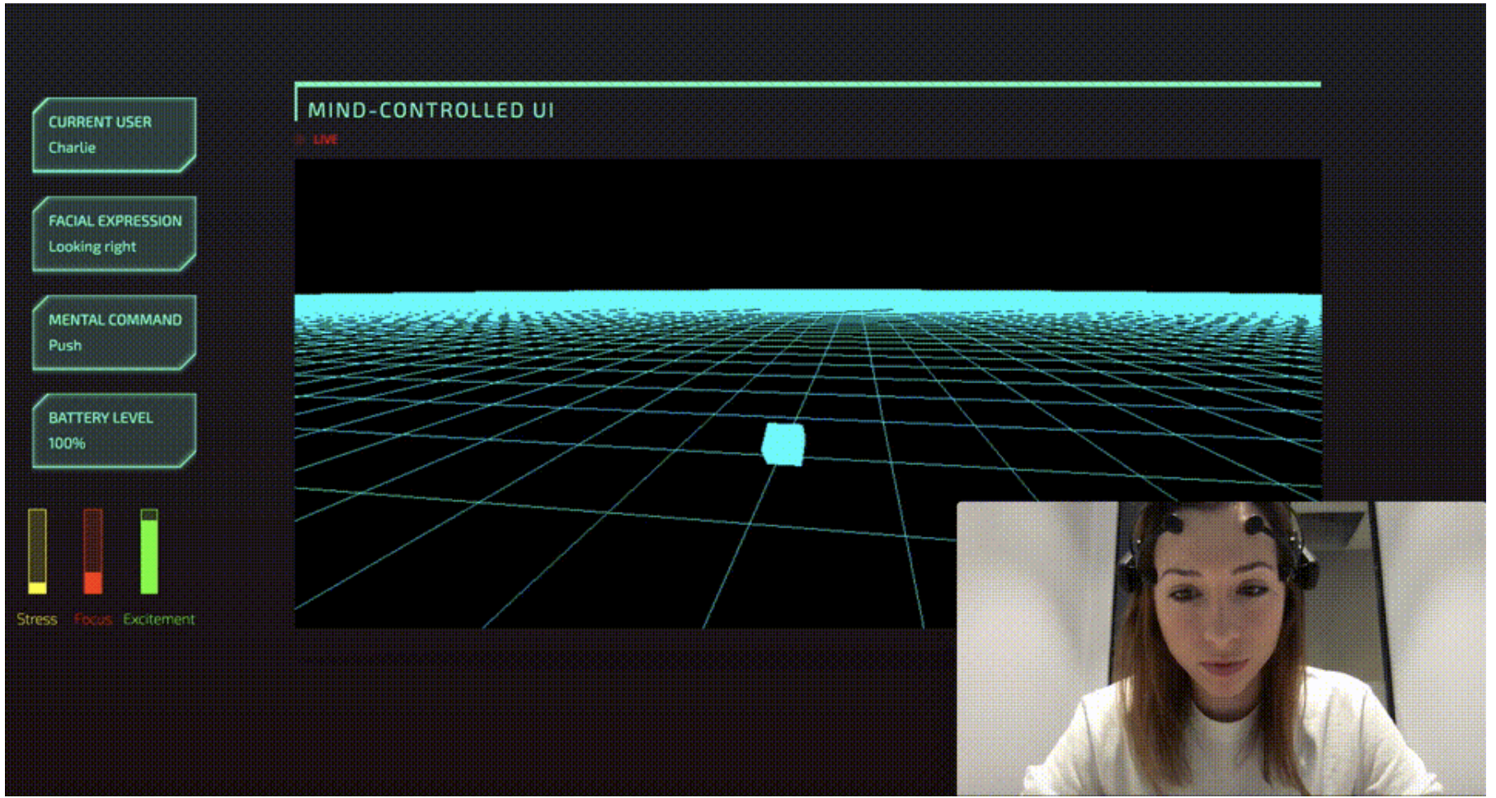
Brain controlled JavaScript - https://github.com/charliegerard/Epoc.js
Overview
Motivation
This framework provides an interface to access data from the Emotiv EPOC brain sensor using Node.js.
A typical interaction with a device or interface involves touching it. Either you’re pressing buttons on a controller, swiping on a touchscreen or clicking on your laptop’s trackpad. But what if you could control things without the use of your hands? What if you could use… your thoughts? https://www.youtube.com/watch?v=7KhFO-qCVyg

Slide 9
Computer Vision
Overview
Motivation
opencv4nodejs - https://www.npmjs.com/package/opencv4nodejs - this package brings the performance of the native OpenCV library to your Node.js application. https://trackingjs.com - library brings different computer vision algorithms and techniques into the browser environment.
Introduction to Computer Vision in JavaScript using OpenCV.js https://scotch.io/tutorials/introduction-to-computer-vision-in-javascript-using-opencvjs

Slide 10
OCR - Optical Character Recognition
Overview
Motivation
Tesseract.js is a pure Javascript port of the popular Tesseract OCR engine. Tesseract.js wraps an emscripten port of the Tesseract OCR Engine.
https://kdzwinel.github.io/JS-OCR-demo/

Slide 11
Desktop Applications
https://www.wired.com/2016/05/javascript-conquered-web-now-taking-desktop/

